Slide 1
P153 – Apple Stock Forecast
Group 1 :
Mr. Beereddy Ravi Sushanth Reddy
Milissa Manuel Dabre
Mr. Pranav Padmakar Matkar
Miss Punam Nivrutti Kurkure
Mr. Vijay P. Sonkamble
Mr. Vinayak
Under the guidance of :
Neha Gupta

Slide 2
Business Objective :
To predict the Apple stock market price for the next 30 days

Slide 3
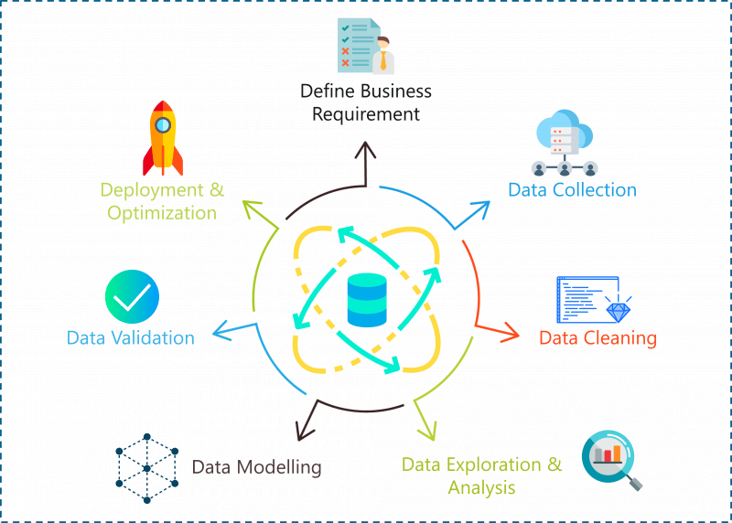
Project Flow :

Slide 4
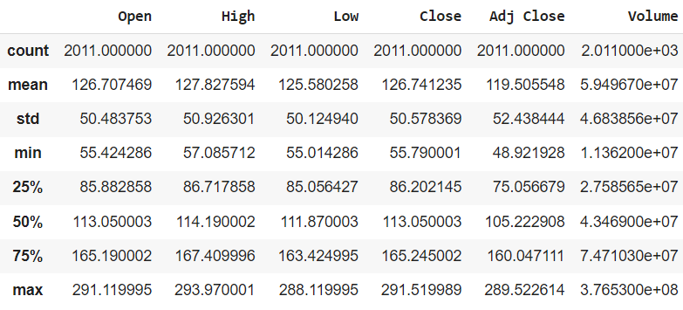
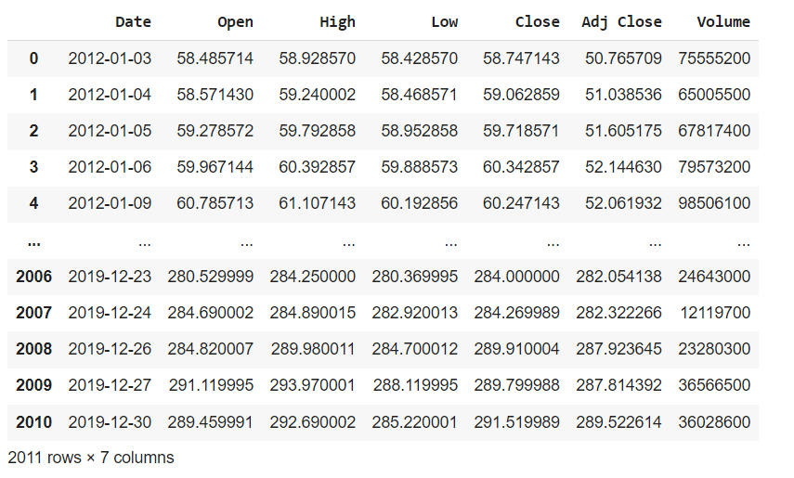
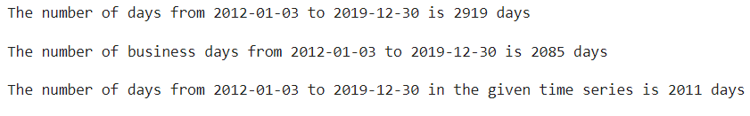
Data Understanding :
There are 2011 rows and 7 columns(Date, Open, High, Low, Close, Adj Close, Volume) in our Apple stock price dataset.
No duplicate values and no null values.
we can see that the time series contains holidays other than weekends.

Slide 5
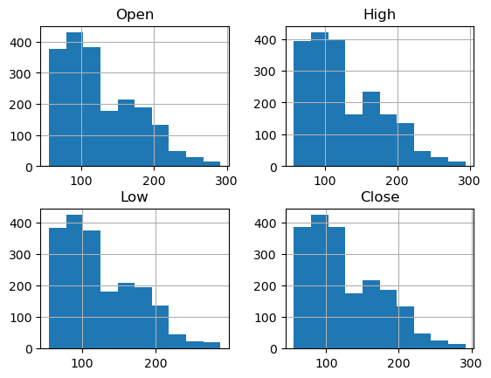
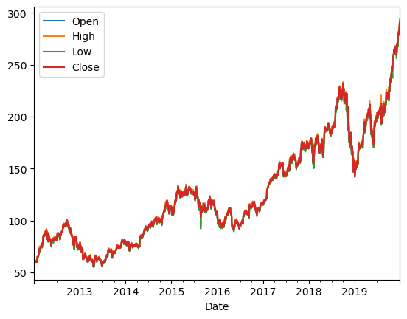
Exploratory Data Analysis(EDA) :
Data Visualization :
Exploratory data analysis uses visual techniques to analyze the data.
It is used to discover trends and patterns our check assumptions with the help of a statical summary and graphic representation.
Line Plot :
It shows that there is an upward exponential trend and data is non-stationary(because mean & variance is not constant)
Histogram Plot :
It shows that data is right skewed.

Slide 6
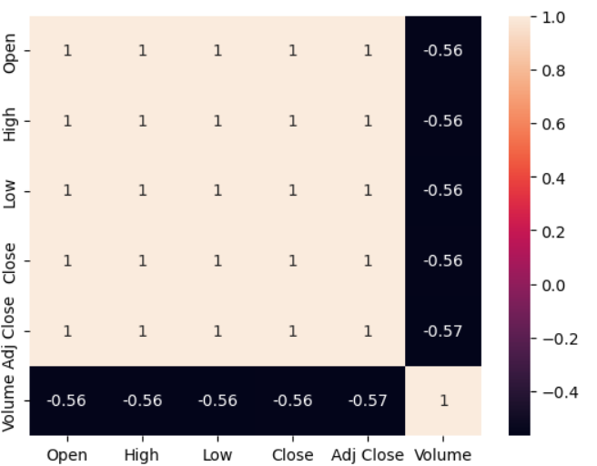
Heat Map :
We eliminate the features like Open, Low, High, and Adj close as they are highly multicollinear with close.
We consider close our target variable. (Because the stock's closing price is the standard benchmark used by investors to track its performance over time)

Slide 7
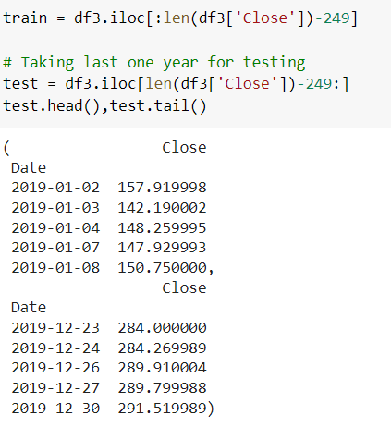
Train and Test Data :
We split the last year’s 2019 data into test data

Slide 8
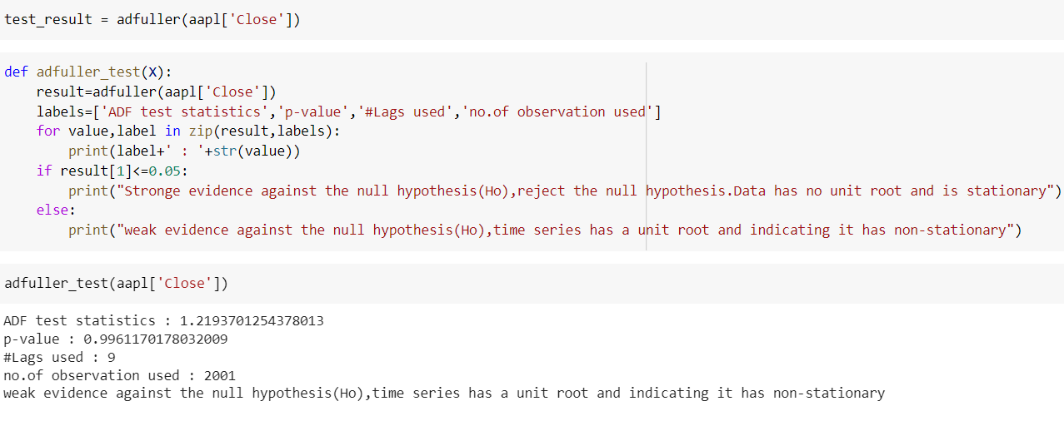
Checking Whether The Data is Stationary Or Not :

Slide 9
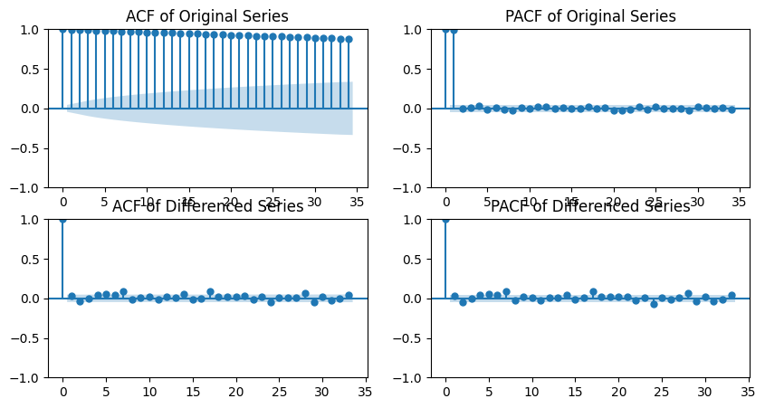
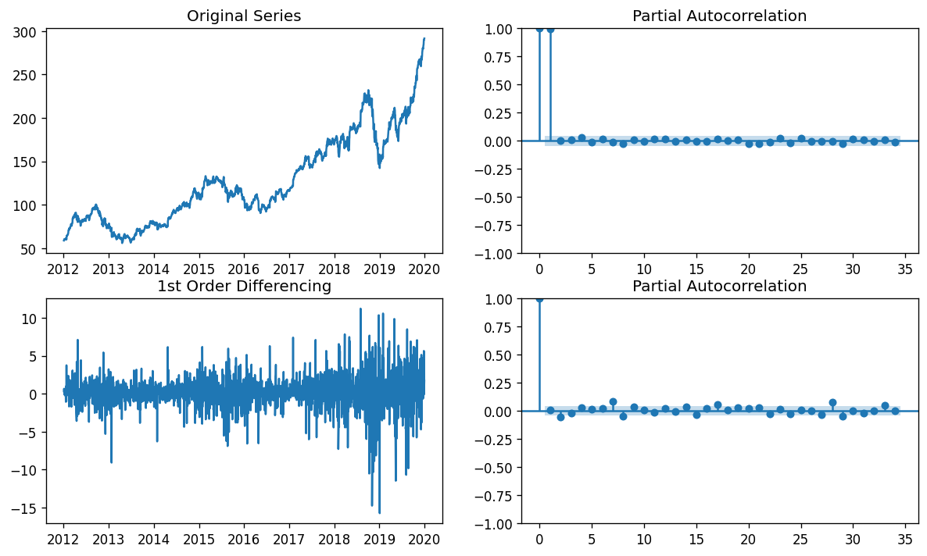
ACF and PACF Plots :
Both ACF and PACF plots, the spike at one is significant so it is the first-order MA model from ACF, q=1, and the first-order AR model from PACF,p=1 --> ARMA(1,1).
Since the time series needed first-order differencing to make it stationary, d=1. So ARIMA(1,1,1)

Slide 10
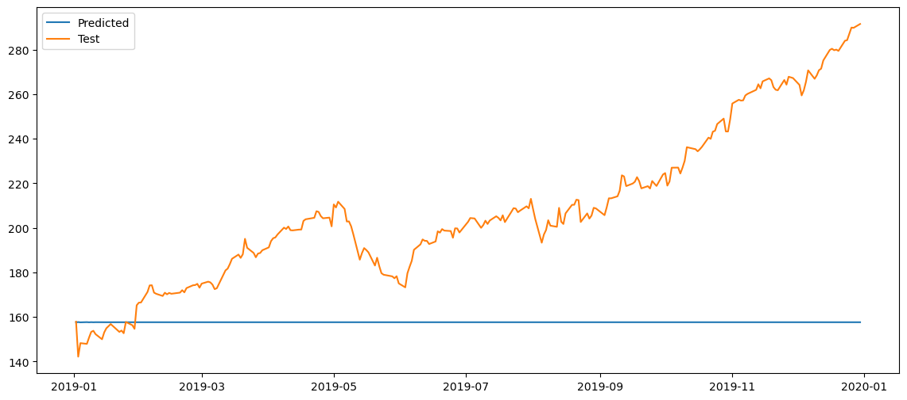
Model Building :
In this phase, We have split our dataset into training and test datasets and built machine-learning models on our dataset.
ARIMA Model :
ARIMA model with order (1,1,1) and RMSE value is 60.429.

Slide 11
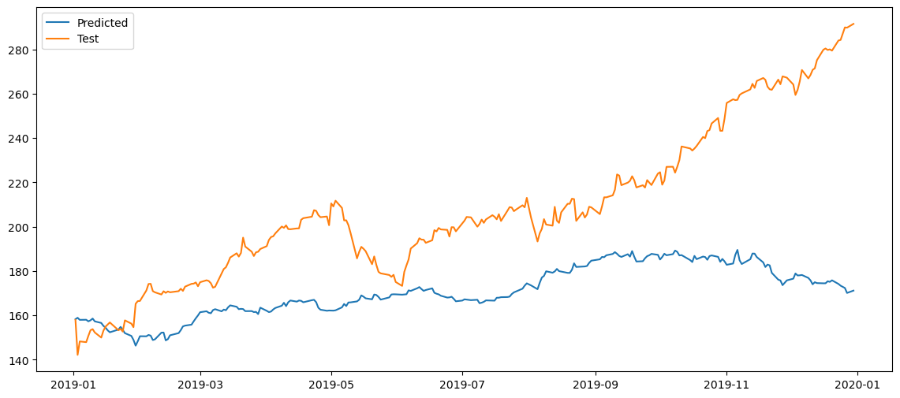
Holts-Winter Triple Exponential Smoothening model :
Order = Trend-Mul, Season-Mul. RMSE value = 45.774

Slide 12
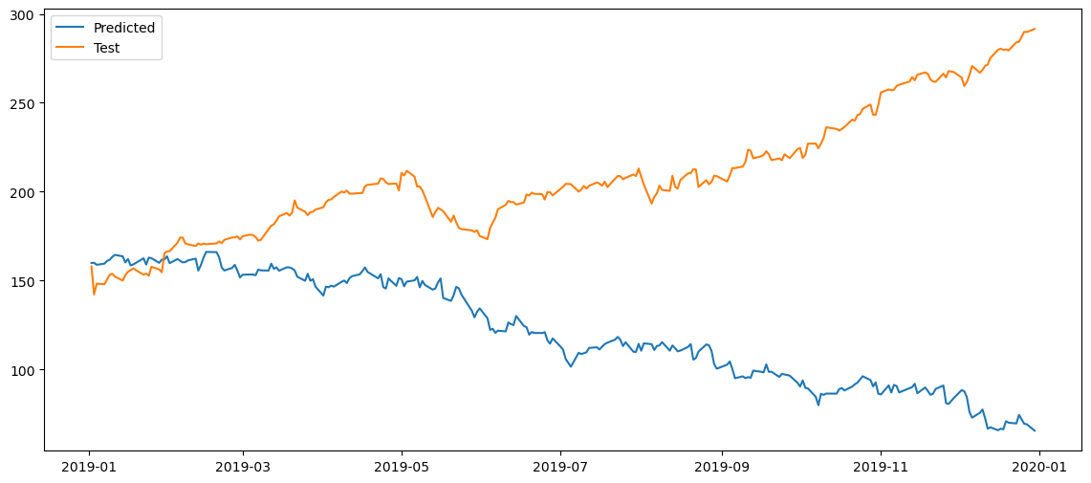
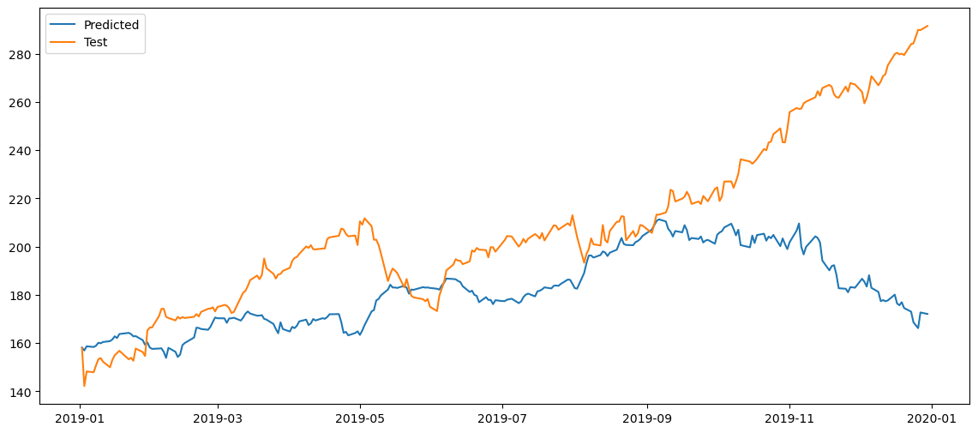
SARIMA Model :
SARIMA Model With Quarterly Seasonality :
SARIMA Model With Annual Seasonality :
SARIMA model with order (1,1,1)x(1,1,0,66) and RMSE value is 105.755.
SARIMA model with order (1,1,1)x(1,1,0,251) and RMSE value is 34.864.

Slide 13
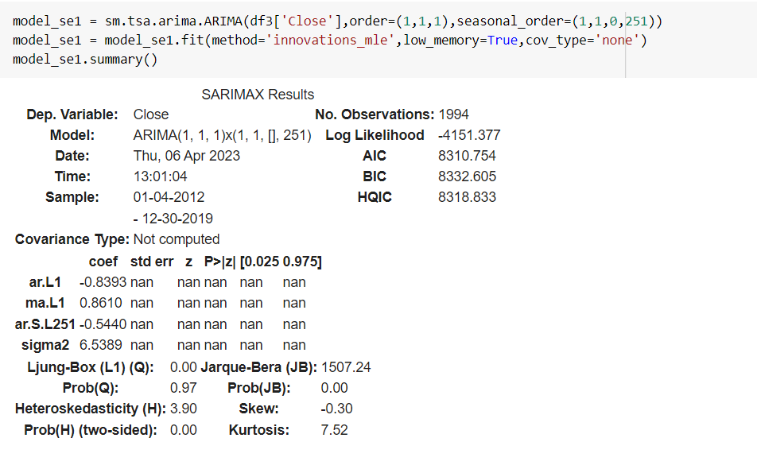
Model Selection :
The Final Model selected is SARIMA(1,1,0,251) which will be trained based on the complete original dataset.
Reason to Choose This Model :
Least RMSE value
Forecasted values vs. Actual Values graphs capture more information when compared to other methods.

Slide 14
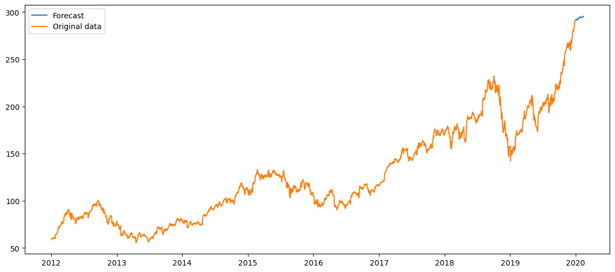
Forecasting for the next 30 days Using SARIMA Model :
 | predicted_mean
2019-12-31 | 289.375677
2020-01-02 | 289.883524
2020-01-03 | 290.392063
2020-01-06 | 282.074457
2020-01-07 | 286.607065
2020-01-08 | 286.342521
2020-01-09 | 288.145626
2020-01-10 | 290.315786
2020-01-13 | 290.243391
2020-01-14 | 289.495483
2020-01-15 | 288.470267
2020-01-16 | 290.374516
2020-01-17 | 292.240550
2020-01-21 | 292.146343
2020-01-22 | 294.187414
2020-01-23 | 292.652486
2020-01-24 | 292.514197
2020-01-27 | 291.151680
2020-01-28 | 293.490661
2020-01-29 | 291.282371
2020-01-30 | 288.858822
2020-01-31 | 293.890090
2020-02-03 | 292.506362
2020-02-04 | 292.000069
2020-02-05 | 294.410552
2020-02-06 | 295.934008
2020-02-07 | 292.003289
2020-02-10 | 288.314956
2020-02-11 | 291.632998
2020-02-12 | 289.286010

Slide 15
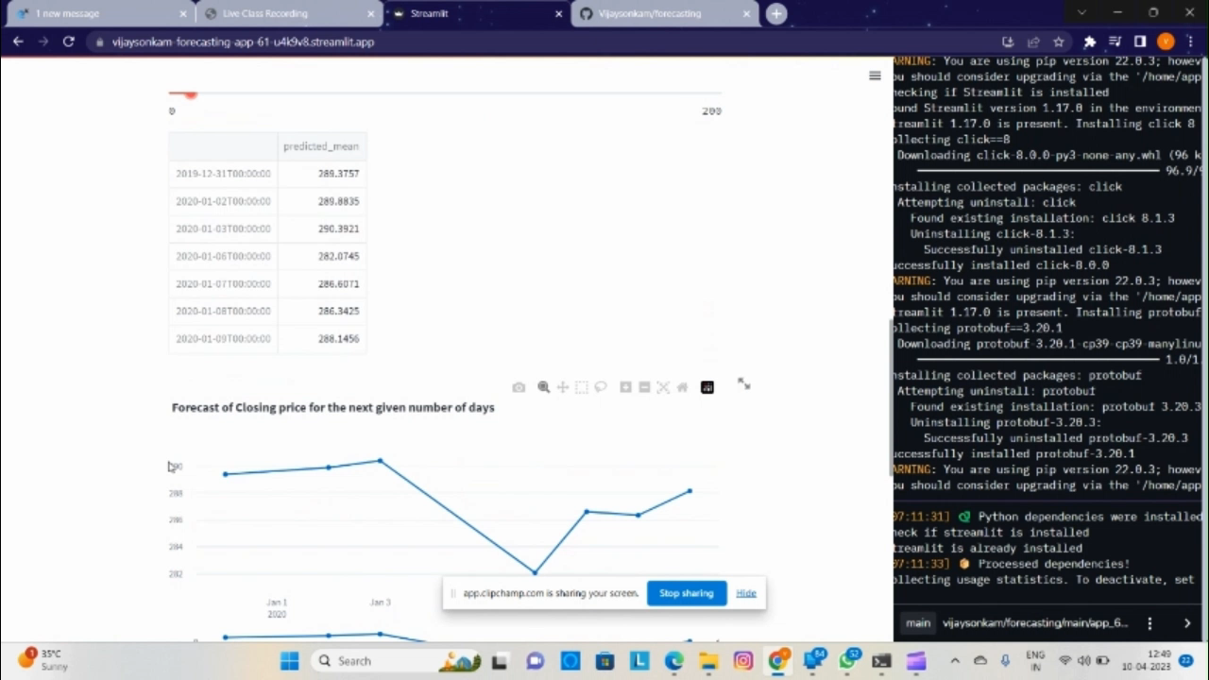
Model Deployment :
In this phase, We deploy our model into the production environment to make particular business decisions based on data.

Slide 16
Conclusion :
We have selected the SARIMA model with annual seasonality because our data is seasonal.
SARIMA has more input parameters than the Holt-Winters method and has a better prediction.
SARIMA model is accurate in short-period forecasting but less accurate in long-period forecasting.

Slide 17
THANK YOU!

